Slide 1
R-Tree Based Spatial Query Processing
COMP3210/6210 ASSIGNMENT 2
Aisik Mitra · Isaac Robbinns · Ismam Sayer
Notes:
Opening (coordinator): introduce the group and the project. We built one shared R-tree and used it for three spatial queries: nearest neighbour with Branch-and-Bound, nearest neighbour with Best-First, and skyline with BBS.

Slide 2
Team and agenda
WHO DID WHAT, AND WHAT WE WILL COVER
Member | Student ID | Individual task
Aisik Mitra | 60859172 | Task 1 - NN search (BaB)
Ismam Sayer | 48541133 | Task 2 - NN search (BF)
Isaac Robbinns (coordinator) | 45904618 | Task 3 - Skyline search (BBS)
All members |  | Shared R-tree, report, slides, video
1
Shared R-tree design and integration
2
Task 1 - Nearest neighbour with BaB
3
Task 2 - Nearest neighbour with Best-First
Dataset selection: (2 + 3 + 8) mod 3 = 1 -> Shop (Task 1), Library (Task 2), City2 (Task 3)
4
Task 3 - Skyline with BBS
5
Results, comparison and key findings
Notes:
Introduce each member and their individual task. Then the order of the talk: shared R-tree first (group task), then each individual task, then comparison and findings. Mention the dataset selection: the sum of the last digits of our student IDs mod 3 gave 1, so we used Shop, Library and City2.

Slide 3
Shared R-tree design
GROUP TASK - ONE MODULE USED BY ALL THREE TASKS
Notes:
Section 1: the shared R-tree (group task). Presented by Ismam.

Slide 4
One R-tree module, three tasks
ONE MODULE BUILDS EVERY TREE; EACH TASK HAS ITS OWN SEARCH
rtree.py
Task 1 - BaB
RTree(B).build(points) Shop dataset · 1 tree + 4 quadrant trees
Point, MBR and Node classes
Choose-subtree (perimeter)
Insertion and overflow handling
Node splitting (x / y sweep)
MBR, parent and root updates
Configurable capacity B
File loaders + verbose step log
Task 2 - Best-First
RTree(B).build(points) Library dataset · 1 tree + 4 y-slice trees
Task 3 - BBS skyline
RTree(B).build(points) City2 dataset · 1 tree + 2 x-half trees
Notes:
rtree.py contains the Point, MBR, Node and RTree classes plus the file loaders. Every task imports it and builds its own tree instances with RTree(B).build(points), including the extra trees for divide-and-conquer. The search algorithms (BaB, BF, BBS) are not in the module - each task implements its own on top of the common tree structure. No R-tree library is used anywhere.

Slide 5
Construction rules (Week 8)
THE SAME RULES ARE USED FOR EVERY TREE IN EVERY TASK
1
Choose subtree
2
Overflow
Child whose MBR needs the smallest perimeter increase to cover the point
Tie -> smaller MBR (area)
A node overflows when it holds B + 1 entries
Every node keeps at least ⌈0.4B⌉ entries after a split
3
Split
4
Update
Sort by x, then by y; try every legal cut
Keep the cut with the smallest perimeter sum of the two MBRs
New node added to the parent; parent split if it overflows
Root split -> new root, tree grows one level
Notes:
Choose-subtree follows the Week 8 rule: minimum perimeter increase, ties broken by the smaller MBR. A node overflows at B+1 entries. The split sorts the entries by x and by y and tries every cut that leaves at least 0.4B entries on each side, keeping the one with the smallest perimeter sum. After a split the new node is linked to the parent; if the root splits, a new root is created, so the tree stays balanced.

Slide 6
Implementation decisions
BUILT FOR 150,000-300,000 POINTS AND FOR STEP-BY-STEP REPORTING
Configurable B - min fill ⌈0.4B⌉ is derived automatically
Fast split - prefix / suffix perimeter sums in one sweep per axis
Cheap MBR updates - MBRs are stretched upwards when no split happens
Memory - Point objects use __slots__
Verbose mode - prints every insert, overflow and split for the report
check() - verifies tight MBRs, capacity, parent links and equal leaf depth
6.1 s
Build 150,000 library points (B = 16)
height 5 · verified with check()
5.5 s
Build the 4 D&C trees for the same data
build time is never part of the timed search
Notes:
Design decisions: B is a parameter so each task can choose its capacity (4 and 5 for the sample analyses). Points use __slots__ to save memory. The split computes prefix and suffix perimeters in one sweep instead of recomputing every MBR. When there is no overflow, MBRs are just stretched on the way up. Verbose mode prints every insertion, overflow and split, which we used to draw the report figures, and check() verifies the tree after building (tight MBRs, capacity, parent links, equal leaf depth). Build times are from our test runs and are not part of the timed searches.

Slide 7
Task 1: BaB search
NEAREST NEIGHBOUR · PRESENTED BY AISIK MITRA
Notes:
Section 2: Task 1, presented by Aisik Mitra.

Slide 8
Branch-and-Bound (BaB) search
DEPTH-FIRST TRAVERSAL, PRUNED BY MINDIST
1
Sort children
BaB(u, q):
if u is a leaf:
if NN of q in u closer than p_best:
p_best = NN of q in u
else:
sort MBRs in u by mindist(q, r)
for each r in sorted order:
if mindist(q, r) < ||q, p_best||:
BaB(child of r, q)
# call BaB(root, q), p_best = none
Order the MBRs in the node by mindist to q
2
Go deep first
Recurse into the closest child before the others
3
Prune
Skip a child if mindist ≥ ||q, p_best||
4
Update at leaves
Keep the closest point found so far as p_best
Notes:
Aisik Mitra explains BaB: it is a depth-first search. At each internal node the child MBRs are sorted by mindist to q and visited in that order, but only while mindist is smaller than the distance to the best point found so far. At a leaf it updates p_best. Backtracking then prunes the remaining branches. (Make sure the slide matches your final code.)

Slide 9
BaB with divide-and-conquer
2 × 2 GRID FROM THE MIDPOINTS OF THE X AND Y RANGES
Divide: split the space into four rectangles at mid_x and mid_y
Build: one R-tree per quadrant with the shared module (same B)
Conquer: run BaB independently on each of the four trees
Combine: the closest of the four candidates is the final NN
Q2 R-tree
Q4 R-tree
Q1 R-tree
Q3 R-tree
mid_x = (min_x + max_x) / 2, mid_y = (min_y + max_y) / 2
Notes:
Aisik Mitra: the data space is cut at the midpoint of the x range and the midpoint of the y range, giving four quadrants. Each quadrant gets its own R-tree from the shared module. For every query BaB runs on all four trees, and the closest of the four candidates is the answer.

Slide 10
Task 1 results
SHOP DATASET · 150,000 POINTS · 200 QUERIES · B = 4
10.60 s
932×
397×
Sequential scan
150,000 distances per query
BaB faster than scan
0.0114 s for 200 queries
BaB + D&C faster than scan
0.0267 s for 200 queries
All 200 queries: the three methods return the same distance (verified in code)
Both R-tree methods are far above the 5× efficiency target
D&C is slower than one tree: four independent searches per query, no pruning across quadrants
Notes:
Aisik Mitra: all three methods return the same nearest neighbour for every one of the 200 queries. Only the search loop is timed. (Update these numbers if the code changes before submission.)

Slide 11
Task 2: Best-First search
NEAREST NEIGHBOUR · PRESENTED BY ISMAM SAYER
Notes:
Section 3: Task 2, presented by Ismam.

Slide 12
Best-First (BF) search
ONE GLOBAL PRIORITY QUEUE, ALWAYS OPEN THE CLOSEST ENTRY
1
Start
H = [(mindist(q, root), 0, root)]
while H and best_dist > H[0][0]:
mind, _, node = heappop(H)
if not node.is_leaf:
for child in node.entries:
heappush(H, (child.mbr
.min_dist(q.x, q.y), c, child))
else:
for p in node.entries:
if dist(p, q) < best_dist:
best_dist, p_best = ...
Put the root into H with its mindist
2
Remove the closest
Pop the entry with the smallest mindist
3
Expand or check
Internal: push children · Leaf: update p_best
4
Stop early
When ||q, p_best|| ≤ smallest mindist in H
Notes:
Ismam: Best-First keeps every entry that has been seen but not opened in one list H, sorted by mindist to the query. Each loop removes the entry with the smallest mindist. An internal node puts its children into H; a leaf updates p_best. It stops as soon as the best distance is not greater than the smallest mindist left in H, because nothing in H can hold a closer point. In Python, H is a heapq min-heap of (mindist, counter, node); the counter is only a tie-breaker.

Slide 13
Task 2 program design
ONLY THE SEARCH LOOP IS TIMED
Load
Build
Search (timed)
Output
load_points()
dataset + 200 queries
RTree(B=16).build()
+ 4 D&C trees
sequential_scan
best_first
best_first_dc
compare results
Task2_output_library.txt
D&C split: sort points by y, cut into 4 groups of almost equal size, one R-tree each
Correctness check: the program counts queries where the three methods disagree (result: 0)
Libraries: sys, time, math, heapq only - no R-tree library
Notes:
Ismam: Task2.py reads the data, builds one R-tree and four y-slice trees with the shared module (not timed), then run_method times only the loop over the 200 queries for each method. After timing it formats the lines, checks that all three methods agree on every distance and writes one output file. Only sys, time, math and heapq are used.

Slide 14
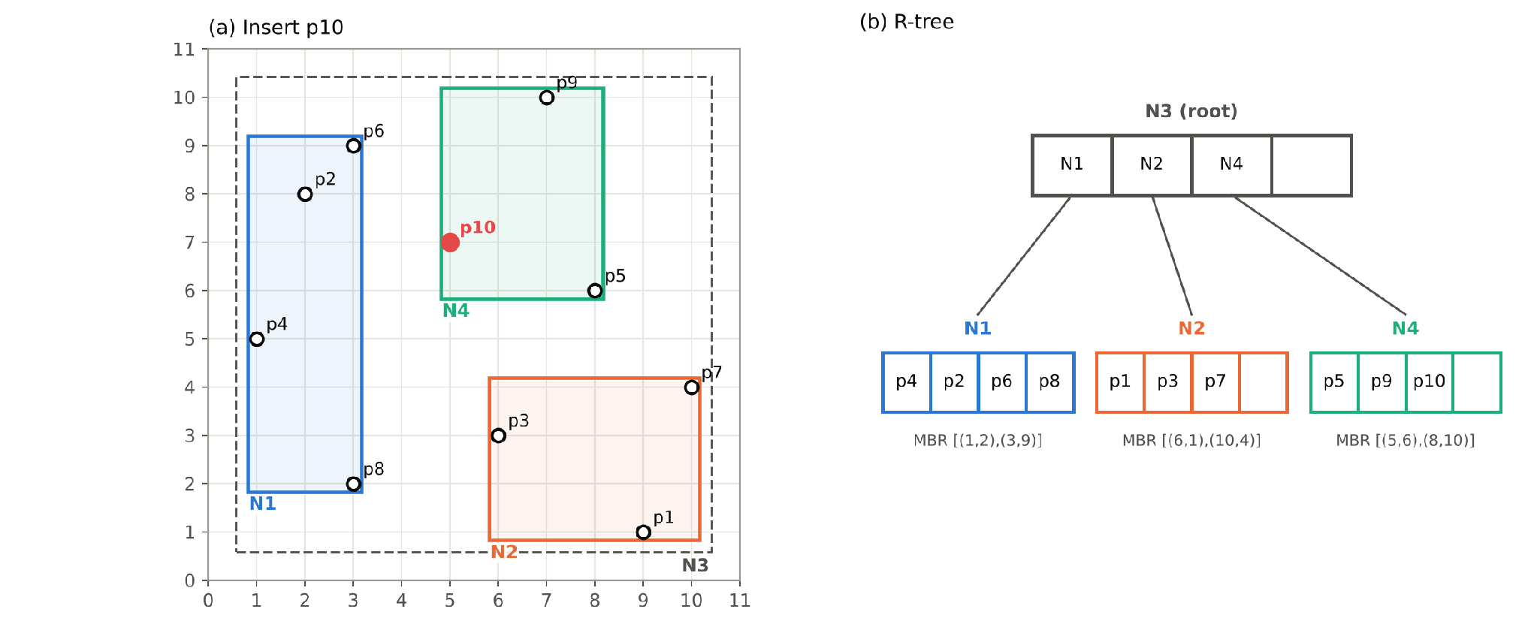
Task 2 sample: building the R-tree
10 POINTS, B = 4, TWO OVERFLOWS
p5 -> N1 overflows
Split on x, perimeter sum 24, new root N3
p9 -> N2 overflows
Split on y, perimeter sum 24, N4 added
p8, p10 ties
Equal increase -> smaller MBR chosen
Notes:
Ismam: on the 10 sample points, p5 makes N1 overflow; the best cut is on the x-axis (perimeter sum 24) and a new root N3 is created. p9 makes N2 overflow; this time the y-axis cut wins (also 24) and N4 joins the root. p8 and p10 were ties in perimeter increase, so the smaller MBR was chosen, as the Week 8 rule says. This is the final tree.

Slide 15
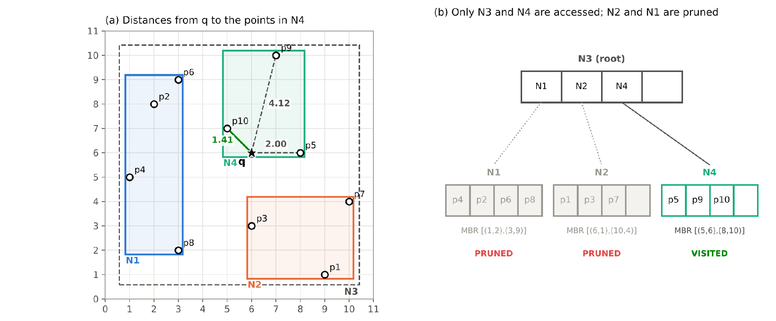
Task 2 sample: BF search for q(6,6)
ONLY THE ROOT AND ONE LEAF ARE OPENED
Step | H after step
Start | (N3, 0)
Pop N3 | (N4,0) (N2,2) (N1,3)
Pop N4 | (N2,2) (N1,3)
Stop | 1.41 ≤ 2 -> p10
NN = p10(5,7), distance 1.41
3 distances instead of 10
Notes:
Ismam: H starts with the root. After opening N3, H holds N4 at mindist 0, N2 at 2 and N1 at 3. BF opens N4 and finds p10 at distance 1.41. Since 1.41 is not greater than 2, the smallest mindist left, it stops. N1 and N2 are never opened, so only 3 of the 10 distances are computed.

Slide 16
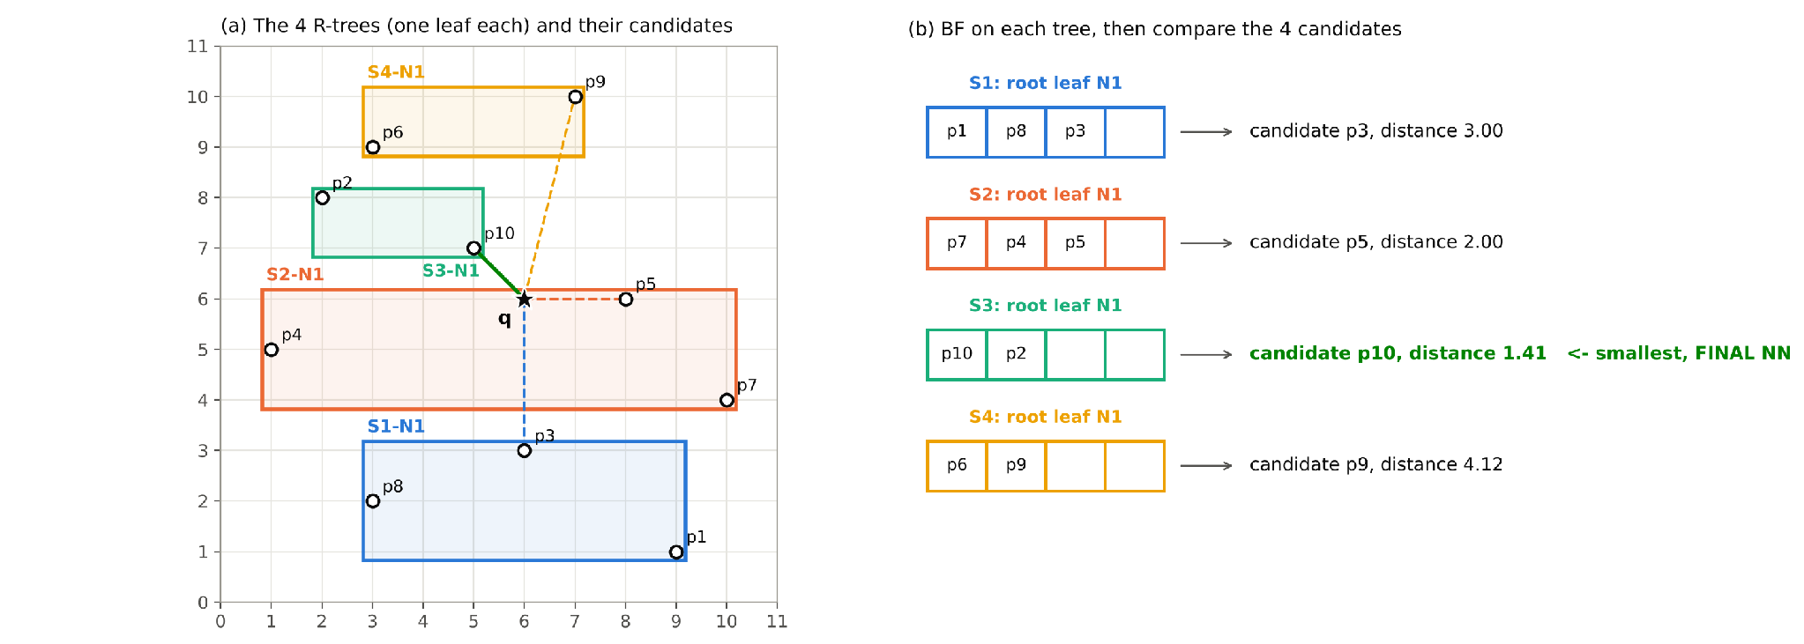
Task 2 sample: BF with divide-and-conquer
SORT BY Y, FOUR SLICES OF 3 / 3 / 2 / 2 POINTS
Divide
Sorted by y, 4 almost equal slices
Conquer
BF on each slice tree on its own
Combine
Closest candidate: p10, 1.41 - same as BF
Notes:
Ismam: the points are sorted by y and cut into four slices. Each slice gets its own R-tree, which here is just one leaf. BF runs on each tree separately, giving candidates p3, p5, p10 and p9. The closest, p10 at 1.41, is the same answer as plain BF. But D&C computed all 10 distances, because a good candidate in one slice cannot prune the others.

Slide 17
Task 2 results
LIBRARY DATASET · 150,000 POINTS · 200 QUERIES · B = 16
3.46 s
662×
255×
Sequential scan
150,000 distances per query
BF faster than scan
0.0052 s for 200 queries
BF + D&C faster than scan
0.0136 s for 200 queries
0 of 200 queries disagree between the three methods
BF only opens nodes whose MBR could still hold a closer point
D&C: four separate heaps, so the best distance in one slice never prunes another
Notes:
Ismam: the sequential scan takes about 3.5 seconds for 200 queries. BF takes 0.0052 seconds, about 662 times faster, and BF with D&C 0.0136 seconds, about 255 times faster. All 200 answers agree across the three methods. D&C is slower than plain BF because each query runs four separate searches.

Slide 18
Task 3: BBS skyline
SKYLINE SEARCH · PRESENTED BY ISAAC ROBBINS
Notes:
Section 4: Task 3, presented by Isaac Robbinns.

Slide 19

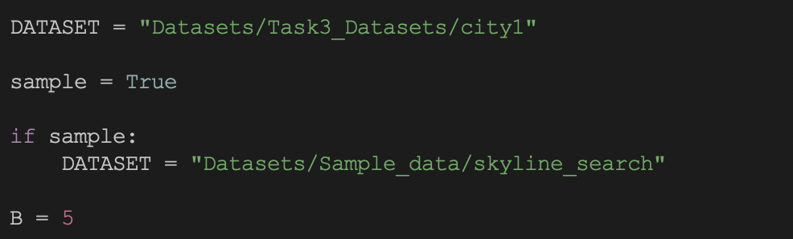
Task 3 dataset
Home id
Cost
Price / m^2
Standard Dataset: Datasets/Task3_Datasets/city1 (300000 points), B=5
Sample Dataset: Datasets/Sample_data/skyline_search (15 points), B=5
Notes:
Isaac Robbinns: these are the times from Task3_output.txt, run on the 15-point sample. All three methods return the same skyline: p6, p2, p8, p12, p5. On such a small input the sequential scan is fastest, because building the heap and checking MBRs costs more than scanning 15 points; the R-tree pays off on large datasets.

Slide 20
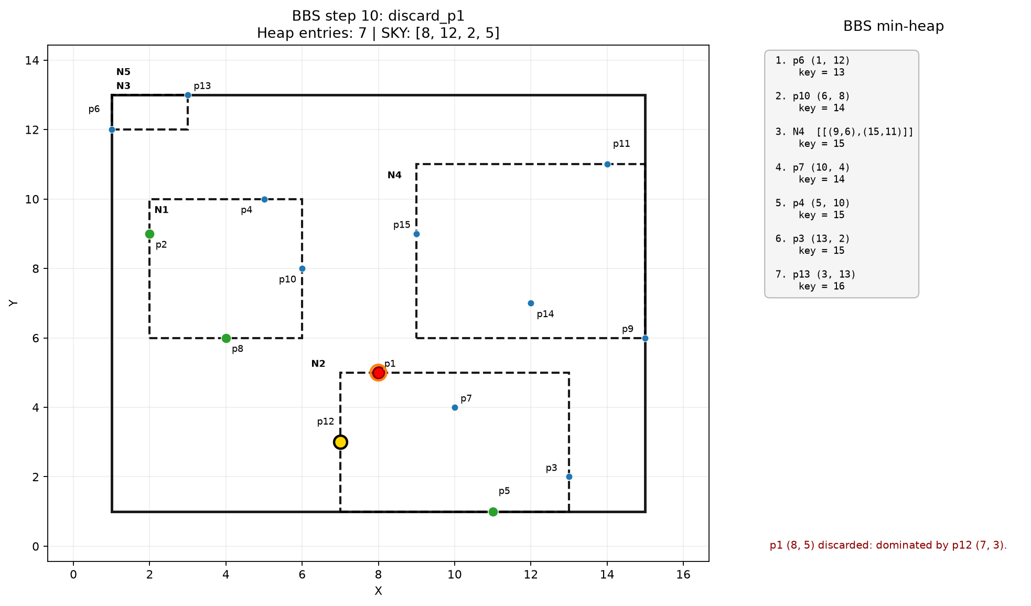
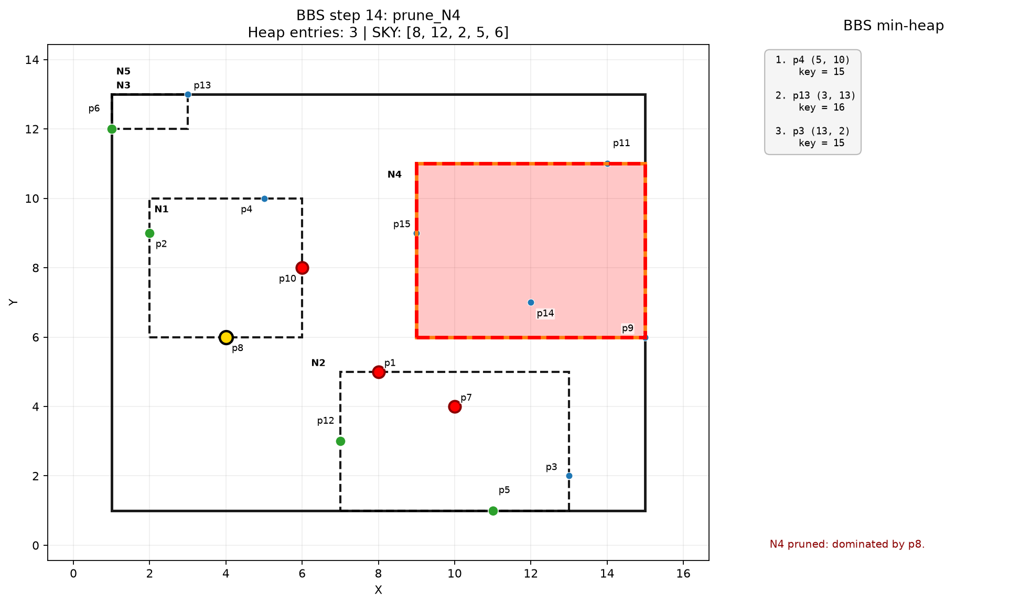
What does it mean to be better

Slide 21
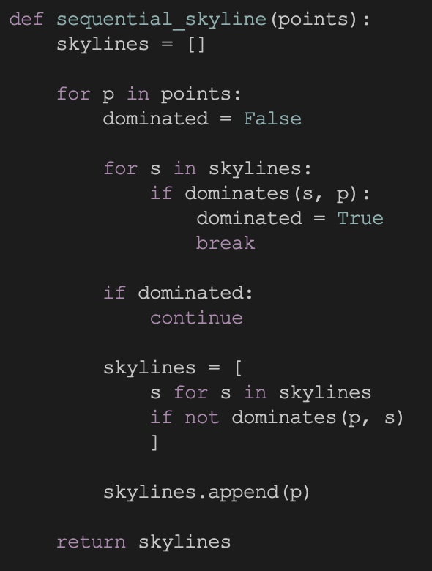
Sequential
Brute forcing a skyline
Good for small datasets, becomes very costly with big ones
Look at all points. If this point dominates any point in our existing skyline, add it to the skyline and remove any points it dominates.

Slide 22

Branch-and-Bound Skyline (BBS)
SMALLER COST AND PRICE PER M² ARE BOTH BETTER
Dominance: p ≤ q in both dimensions and < in at least one
Heap key: x1 + y1 of the MBR (lower-left corner to origin)
Node: pruned if a skyline point dominates its lower-left corner, else expanded
Point: added to the skyline if no skyline point dominates it
Sample result: p6, p2, p8, p12, p5
Notes:
Isaac Robbins: a home dominates another if it is no worse in both cost and price per square metre and strictly better in one. BBS keeps a min-heap keyed by x1 + y1 of each entry, the distance of its lower-left corner from the origin. A node whose lower-left corner is dominated by a skyline point is pruned without opening it. In the sample, N4 is pruned because p8 dominates its corner.

Slide 23
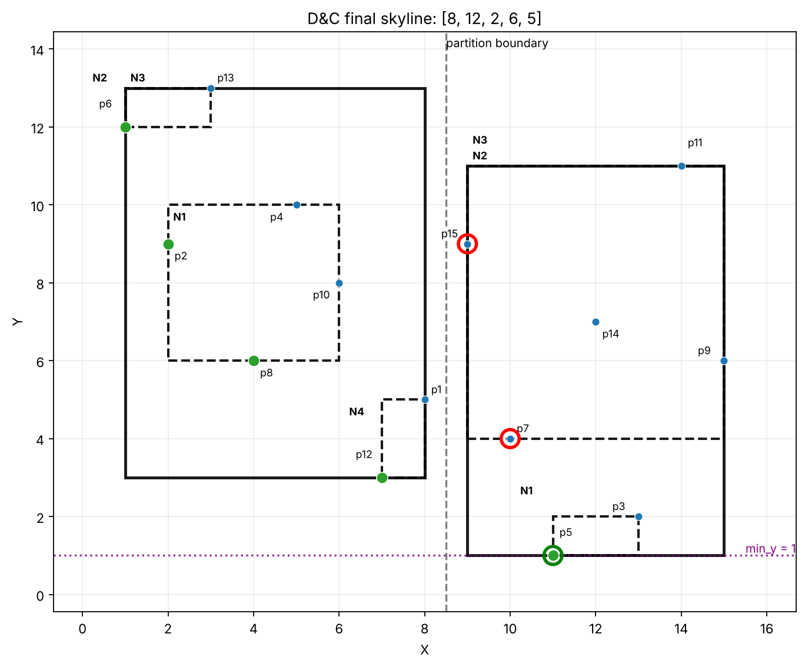
BBS with divide-and-conquer
TWO X-HALVES, LOCAL SKYLINES, THEN 1D DOMINANCE SCREENING
Divide
Sort by x, two halves of almost equal size
Conquer
BBS on each half -> two local skylines
Combine
Keep all left points; keep a right point only if y < min_y
Sample
Right candidates p15, p7 rejected, p5 kept -> same skyline as BBS
Notes:
Isaac Robbinns: points are sorted by x and split into two halves, each with its own R-tree. BBS gives a local skyline for each half. Every left skyline point survives, because nothing on the right has a smaller x. A right point is kept only if its y is smaller than the smallest y seen so far (min_y). In the sample, p15 and p7 are rejected and p5 is kept.

Slide 24
Task 3 results
City1 Dataset · 300k HOMES · B = 5
50.030ms
0.372ms
0.775ms
Sequential scan
300000 points
BBS
one R-tree, B = 5
BBS + D&C
two x-half trees + screening
All three methods return the same skyline
On 300k points a single BBS is faster
BBS gains come from pruning whole dominated nodes, which matters on large datasets
D&C is slower because points in the left can’t prune nodes on the right. Most points are in the left tree, so the right BBS algorithm wastes a lot of time
Height 10
Notes:
Isaac Robbinns: these are the times from Task3_output.txt, run on the 15-point sample. All three methods return the same skyline: p6, p2, p8, p12, p5. On such a small input the sequential scan is fastest, because building the heap and checking MBRs costs more than scanning 15 points; the R-tree pays off on large datasets.

Slide 25
What if B is bigger?
City1 Dataset · 300k HOMES · B = 16
46.390ms
1.311ms
1.641ms
Sequential scan
300000 points
BBS
one R-tree, B = 16
BBS + D&C
two x-half trees + screening
Height 6
With smaller B, nodes generally contain fewer points, producing smaller MBRs.
Smaller MBRs can provide tighter lower-left bounds, allowing BBS to determine that entire subtrees are dominated without examining their contents.
With larger B, nodes contain more points, producing larger MBRs. These can overlap more of the search space, making their lower-left corners less useful for pruning.
But wait, Sequential scan doesn’t use B, why did it change?
Notes:
Isaac Robbinns: these are the times from Task3_output.txt, run on the 15-point sample. All three methods return the same skyline: p6, p2, p8, p12, p5. On such a small input the sequential scan is fastest, because building the heap and checking MBRs costs more than scanning 15 points; the R-tree pays off on large datasets.

Slide 26
Sample Dataset
15 HOMES · B = 5 (RESULTS AS PROVIDED)
~0.000031 s
~0.000037s
~0.000028 s
Sequential scan
15 points
BBS
one R-tree, B = 5
BBS + D&C
two x-half trees + screening
All three methods return the same skyline: p6, p2, p8, p12, p5 (sorted by x)
On 15 points the scan is fastest - heap and MBR checks cost more than scanning a tiny input
BBS gains come from pruning whole dominated nodes, which matters on large datasets
Notes:
Isaac Robbinns: these are the times from Task3_output.txt, run on the 15-point sample. All three methods return the same skyline: p6, p2, p8, p12, p5. On such a small input the sequential scan is fastest, because building the heap and checking MBRs costs more than scanning 15 points; the R-tree pays off on large datasets.

Slide 27
Variation in results
Told you I’d come back to it
B=5, Runs=100
Sequential Scan
Mean: 0.000007855 s
Stddev: 0.000005540 s
Median: 0.000006991 s
Min: 0.000006868 s
Max: 0.000057833 s
BBS
Mean: 0.000018324 s
Stddev: 0.000002504 s
Median: 0.000017838 s
Min: 0.000017581 s
Max: 0.000041748 s
Divide and Conquer
Mean: 0.000022941 s
Stddev: 0.000003467 s
Median: 0.000022096 s
Min: 0.000021717 s
Max: 0.000053500 s

Slide 28
Comparing the three tasks
SPEED-UP OVER THE SEQUENTIAL SCAN (HIGHER IS BETTER)
Task | Scan | Index | D&C
1 BaB | 10.60 s | 0.0114 s | 0.0267 s
2 BF | 3.46 s | 0.0052 s | 0.0136 s
3 BBS | 50.030ms | 0.372ms | 0.775ms
Tasks 1 and 2: both index methods far above the 5× target
Single tree beats D&C in both NN tasks
Notes:
Group: for the two nearest-neighbour tasks on 150,000 points, every R-tree method beats the sequential scan by two orders of magnitude, well above the 5× target, and the single tree is faster than its divide-and-conquer version because each partition is searched on its own. Task 3 times are from the 15-point sample, so they are shown in the table only.

Slide 29
Key findings from the case studies
WHAT THE THREE WORKED SAMPLES SHOW
1
BaB vs BF
2
Divide-and-conquer
3
Skyline pruning
BaB is depth-first and may open leaves it later backtracks from
BF keeps one global queue and stops as soon as nothing in H can be closer
Task 2 sample: BF opened 1 of 3 leaves
Task 1: 2 × 2 midpoint grid
Task 2: 4 slices sorted by y
Task 3: 2 x-halves + 1D screening
Partitions are searched on their own -> fewer prunes, slower than one tree
A dominated lower-left corner removes a whole node
Sample: N4 pruned by p8
D&C merge only compares y, because x already orders the halves
Takeaway: a good index plus pruning beats a full scan by two orders of magnitude; partitioning helps only if partitions can prune each other.
Notes:
Group summary of the three worked examples. BaB vs BF: BaB goes depth-first and can open a leaf that later turns out not to hold the answer, while BF uses one global queue and only opens nodes that could still contain a closer point. Divide-and-conquer: the three partition strategies differ (midpoint grid, y-slices, x-halves), but in all of them the partitions are searched independently, which costs extra node accesses. BBS: dominance pruning with the lower-left corner removes whole nodes, and the D&C merge needs only a one-dimensional check.

Slide 30
Thank you
Notes:
Close: thank the audience and invite questions.

